Slide 1

Asteroid Anxiety
Should we worry about Asteroids hitting the earth?
Team 2:
Brooke Robertson, Blake Stephenson, Nayoung Kim, Ilse Styles

Slide 2
Questions and Data Sources
Questions that WE found interesting and what motivated US to answer them
Where and how we found the data used to answer these questions
As we started with a general question about the danger of asteroids, we narrowed down our sub questions to two:
What is the frequency of close encounters between asteroids and Earth?
what factors contribute to the potential danger of an asteroid?
Our motivation included both curiosity and personal interest
WE USED NASA's Near-Earth Object (NEO) web-site AND ASSOCIATED Api ( “Data related to Earth impact risk, close-approaches, and much more”)
https://api.nasa.gov/
After choosing the API, We brought the data into a jupyter notebook , created a dataframe and then created a csv file

Slide 3
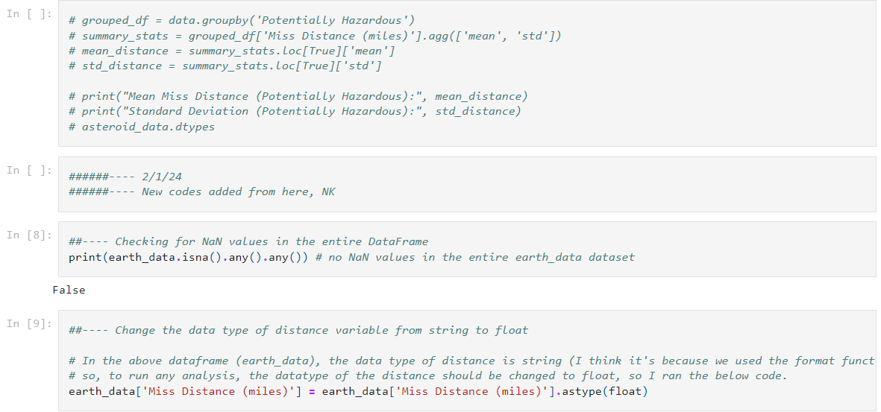
Data exploration and Cleanup process
The data exploration and cleanup process
Jupyter notebook
Description of our process
After choosing the API, We brought the data into a jupyter notebook , created a dataframe and then created a csv file
We also chose the relevant variables to include- name of meteor, date of close approach, velocity, diameter, distance from earth, and hazardous: true/false
Data Cleaning included:
Limited the orbiting body to earth
checked for NaN (null) values in earth_data set to delete
Changed the data type of Distance variable from string to float to be able to use it for graphs anD charts

Slide 4
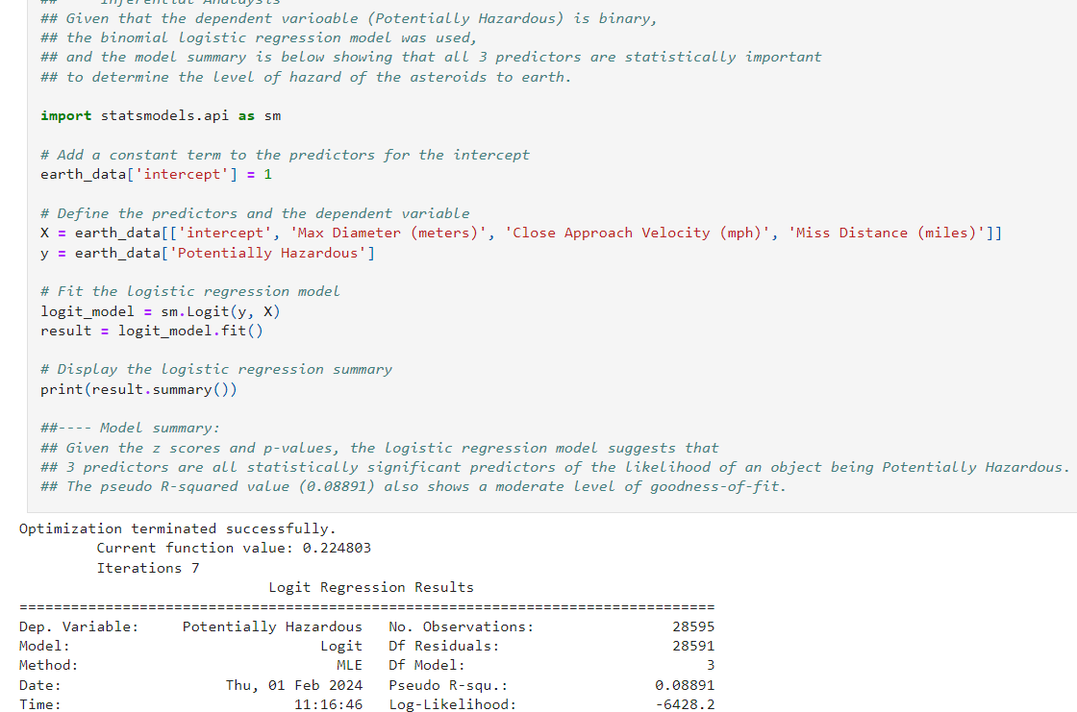
Analysis Process
Description of our process
Wrote codes for summary stats
Created plots to show the relationship between predictors and potentially hazardous asteroids, and frequency of close encounters over time for both hazardous and nonhazardous asteroids
created correlation table and correlation plots among the 3 predictors in our model (velocity, diameter, distance)
ran a binomial logistic regression model for our data since the dependent variable (potentially hazardous) is T/F binary
Example: Binomial Logit Reg. Model

Slide 5
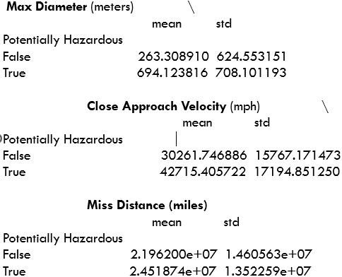
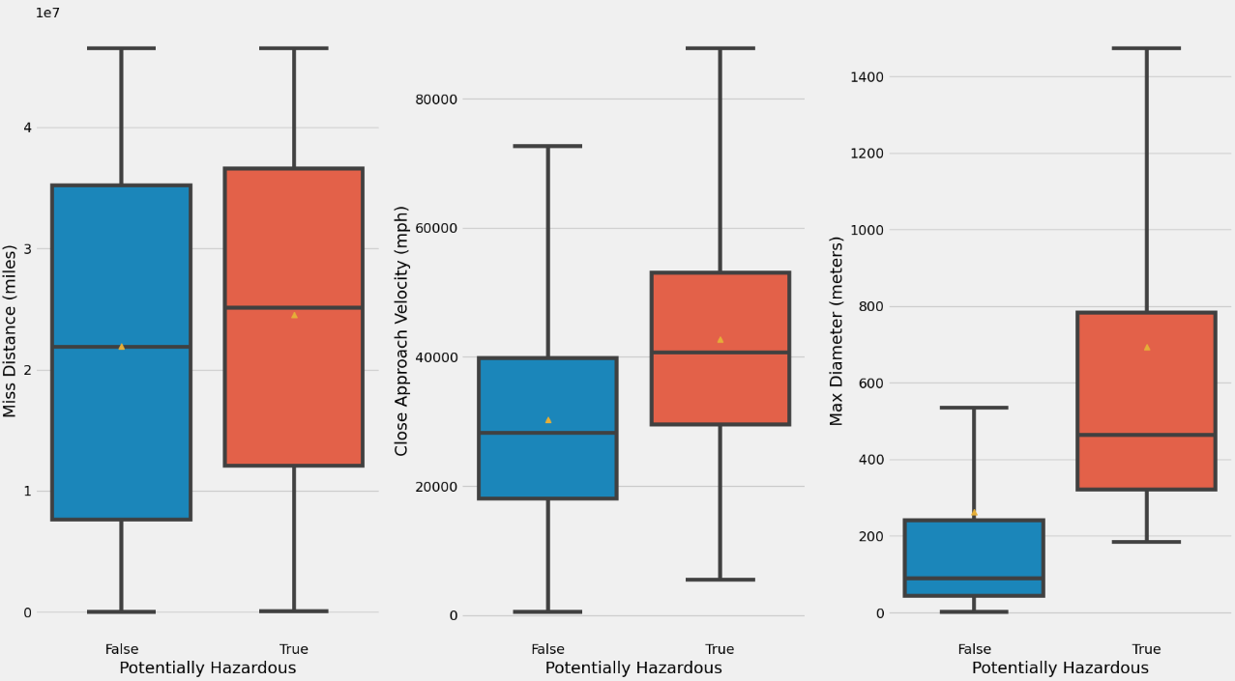
Descriptive statistics

Slide 6
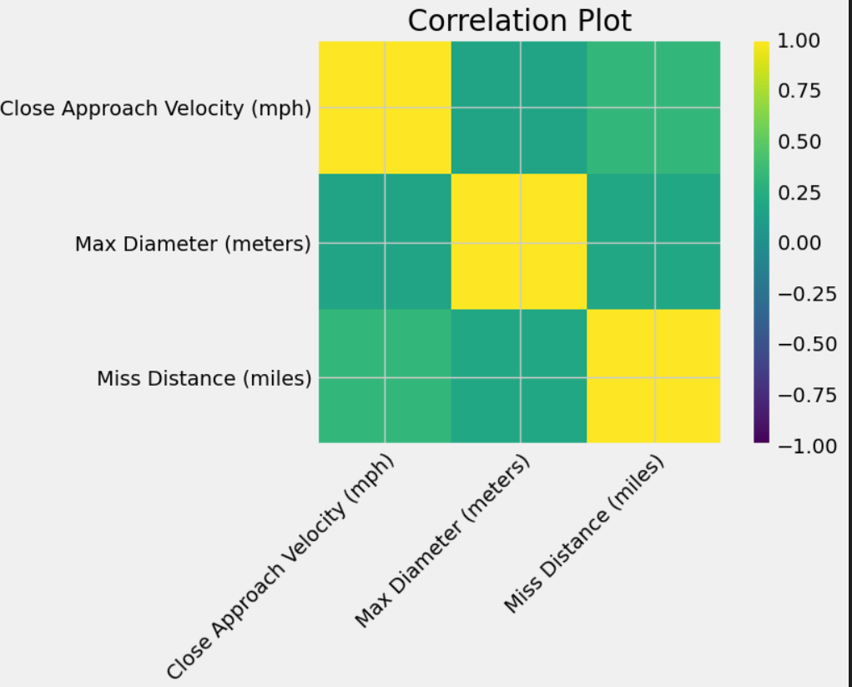
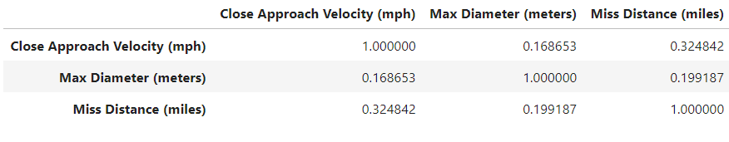
Correlation TABLES/PLOTS

Slide 7
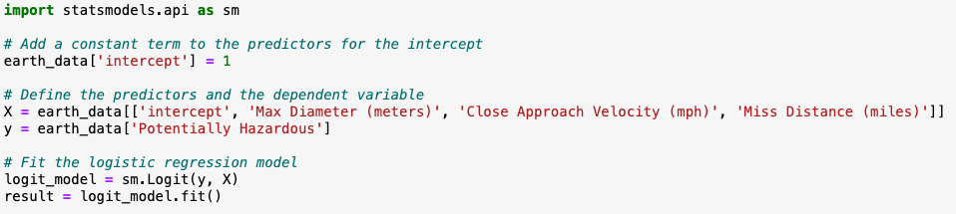
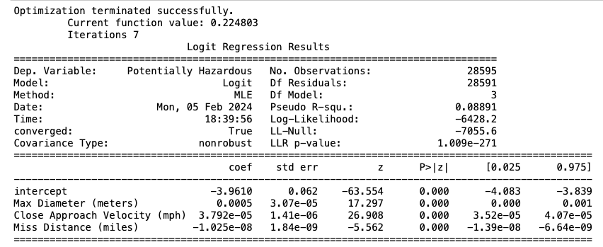
binomial logistic regression model and model summary

Slide 8
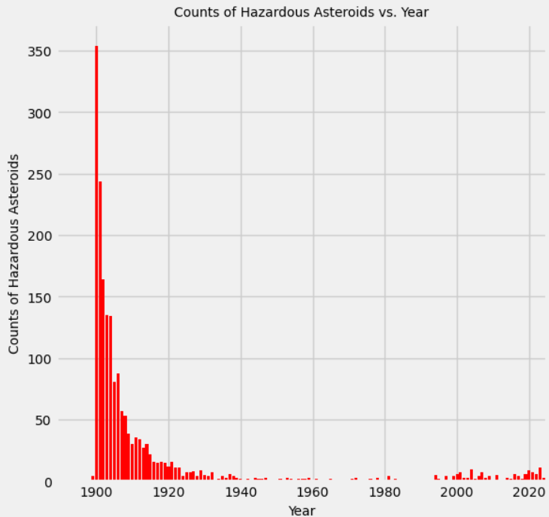
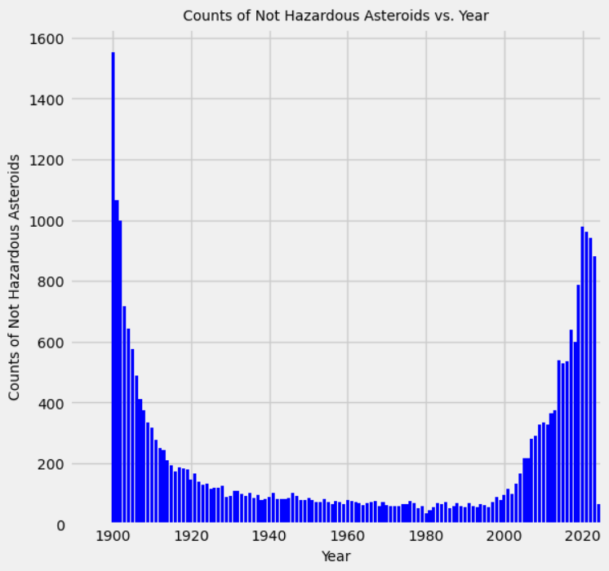
COUNTS of Hazardous/nonhazardous asteroids vs year

Slide 9
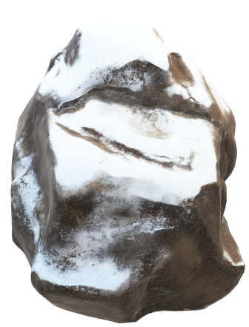
Implications and lessons learned
Although asteroids are a fear that exists in the public conciousness, the actual impact on our daily lives will be almost nonexistent compared to other natural events such as flooding, tornados, hurricanes, and earthquakes. Blake Stephenson offered an analysis from the point of view of a governmental official [add your thoughts here Blake].
We learned a number of things from working on the data and analysis.
One of the most memorable lessons was “if you make a CSV file from an API, always save the CSV file separately!”
We also learned to look carefully at what data is included. For example, a caveat to our Hazardous or Non-Hazardous incidence per year is that in order to have a more workable sample size, we used only the first pass data for each asteroid in the time period (an individual asteroid can have a number of passes around the earth).

Slide 10
Any Questions?

